Slide 1
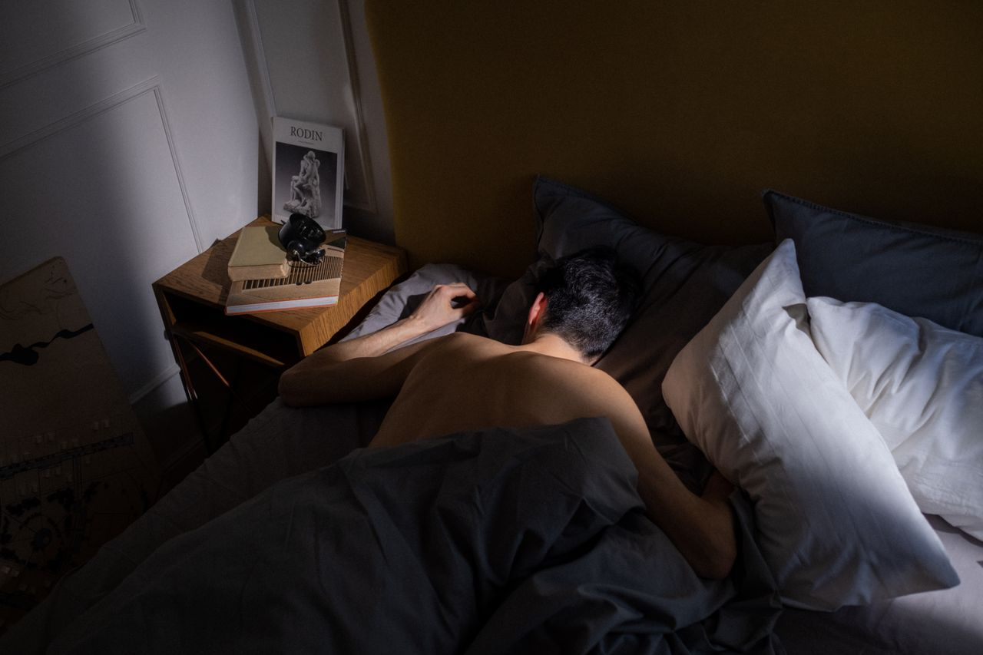
Sleep Science:
Why It Matters
Grades 10–12
Together For Health

Slide 2
67%
of high school students get fewer than 8 hours of sleep — far below the 8–10 hour recommendation
The consequences include impaired cognition, emotional dysregulation, and significantly increased injury risk.
Together For Health

Slide 3
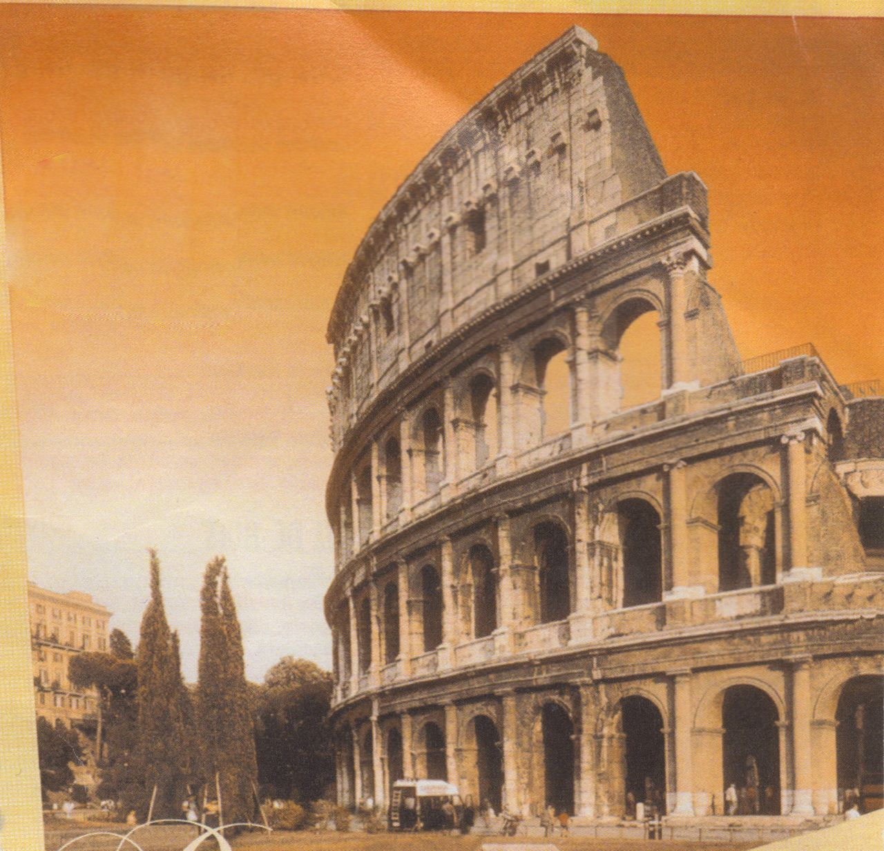
🧬
Sleep Architecture & Stages
NREM Stage 1 & 2: light sleep, transition — easy to wake
NREM Stage 3: deep/slow-wave sleep — physical restoration, growth hormone release
REM sleep: memory consolidation, emotional processing, creativity
Sleep cycles last 90 minutes — 5–6 cycles per night ideally
Cutting sleep short disproportionately cuts REM sleep (occurs most in final cycles)
Together For Health

Slide 4
📉
The Cost of Sleep Debt
Cognitive impairment equivalent to being legally drunk after 24 hours awake
Emotional reactivity: amygdala 60% more reactive with 5 hours sleep vs. 8
Increased risk of Type 2 diabetes (insulin resistance develops within days)
Correlation with obesity: ghrelin (hunger hormone) rises, leptin (fullness) falls
Suppressed immune function: 4× more likely to get sick after exposure
Together For Health

Slide 5

⚡
Optimizing Sleep for Performance
Anchor your wake time — circadian rhythm is set by morning light, not bedtime
1
Strategic napping: 20 min before 3pm — power nap, not sleep debt repayment
2
Caffeine half-life is 5–7 hours — no caffeine after noon for quality sleep
3
Alcohol disrupts REM sleep significantly — even small amounts
4
Exercise improves sleep quality but avoid intense training within 4 hours of bed
5
Together For Health

Slide 6
🏫
School Start Times
Moving school start times from 7:30 to 8:30am increased graduation rates by 11% and reduced car accidents by 16%.
This is a public health issue, not a discipline issue. Advocating for later start times is evidence-based.
Together For Health

Slide 7
KEY TAKEAWAYS
Sleep is the single highest-leverage health behavior available to you
✓
The research is unequivocal: 8–10 hours optimizes every system in your body
✓
Protecting your sleep is protecting your future performance and health
✓
Resources
Why We Sleep by Matthew Walker (book/YouTube)
Sleep Foundation: sleepfoundation.org
Talk to your doctor if experiencing chronic insomnia
Together For Health

